Slide 1
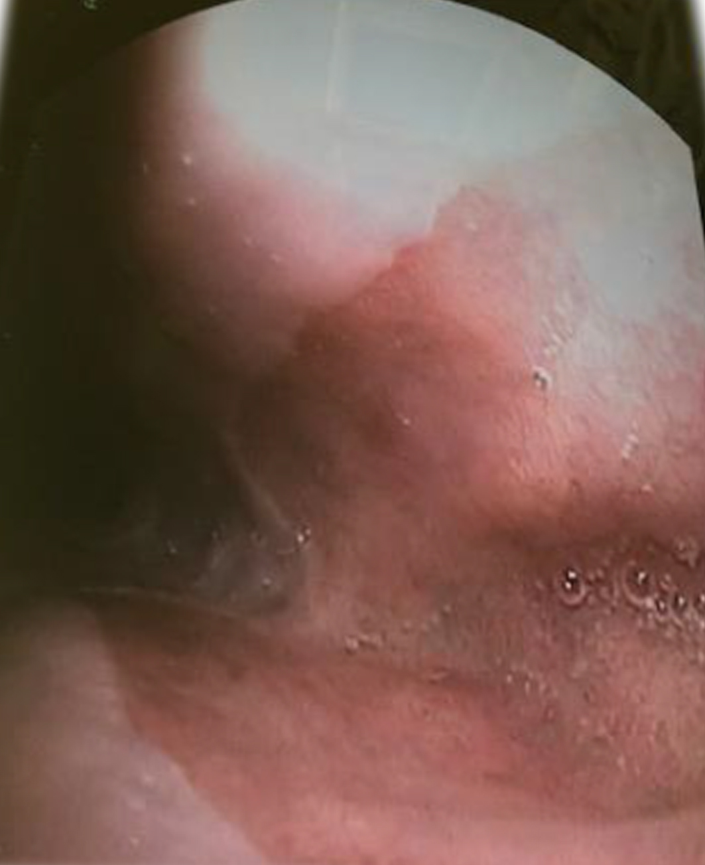
Large Upper esophageal ulcer

